Slide 1
2023-25 NFHS Basketball Mechanics

Slide 2
Sponsor Slide
remove this text and place artwork centered here

Slide 3
MECHANIC CHANGES
2023-25 Basketball Officials Manual Update

Slide 4
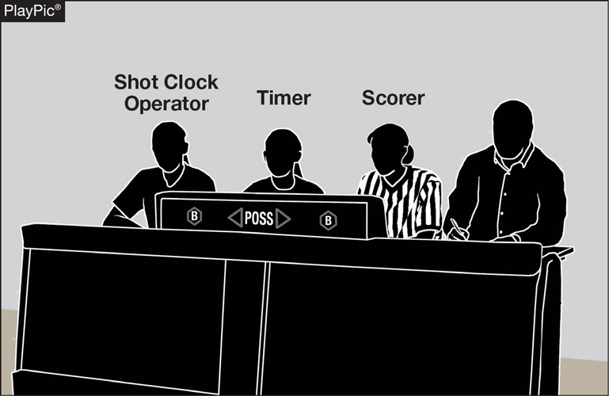
GAME AND TABLE OFFICIALS 2-1-3 NOTE
If utilizing a shot clock, the shot clock operator shall be located at the scorer’s and timer’s table.
This allows the officiating crew to quickly identify the person who is operating the shot clock should there be a timing issue that needs to be addressed.
Notes:
If utilizing a shot clock, the shot clock operator shall be located at the scorer’s and timer’s table.
Rationale: This allows the officiating crew to quickly identify the person who is operating the shot clock should there be a timing issue that needs to be addressed.

Slide 5
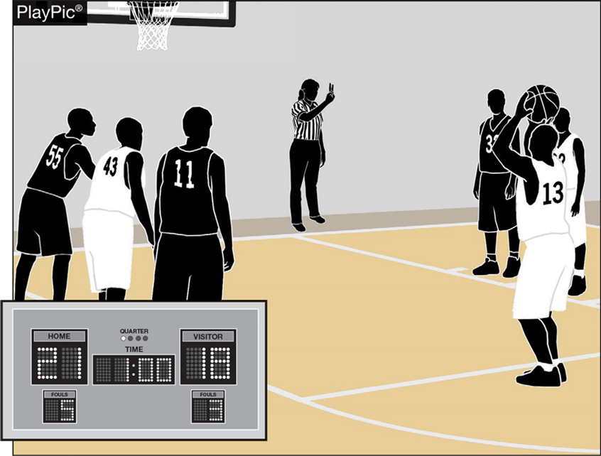
BONUS FREE THROWS 4-8-1
Two free throws will now be awarded for all common fouls, except for a player-control foul or team-control foul, beginning with the fifth team foul in each quarter.
Team fouls will be reset to zero at the end of each quarter, excluding the fourth quarter if an overtime period is needed.
Notes:
Two free throws will now be awarded for all common fouls, except for a player-control foul or team-control foul, beginning with the fifth team foul in each quarter.
Team fouls will be reset to zero at the end of each quarter, excluding the fourth quarter if an overtime period is needed.
Rationale: Improves flow by providing an opportunity for teams to adjust their play by not carrying over fouls from quarters 1 and 3 to quarters 2 and 4 while significantly reducing the opportunity for correctable errors to occur. Minimizes risk of injury by eliminating the one-and-one and reducing opportunities for rough play during rebounding opportunities.

Slide 6
Resumption of play procedure, throw-ins 7-5-2 thru 4 (NEW)
After an out of bounds violation in either the frontcourt or the backcourt by either team, the throw-in shall be at the designated spot nearest to where the ball went out of bounds.
Notes:
After an out of bounds violation in either the frontcourt or the backcourt by either team, the throw-in shall be at the designated spot nearest to where the ball went out of bounds.

Slide 7
Resumption of play procedure, throw-ins 7-5-2 thru 4 (NEW)
After a violation or a foul before the bonus is in effect by either team or any other stoppage in play, the throw-in location will be determined by the location of the violation/foul or the location of the ball when the stoppage occurs:
Frontcourt throw-in – one of the newly established four designated spots (28-foot mark along each sideline or 3-feet outside the lane line along the end line).
Backcourt throw-in – the designated spot nearest the foul, violation or other stoppage.
Notes:
After a violation or a foul before the bonus is in effect by either team or any other stoppage in play, the throw-in location will be determined by the location of the violation/foul or the location of the ball when the stoppage occurs:
Frontcourt throw-in – one of the newly established four designated spots (28-foot mark along each sideline or 3-feet outside the lane line along the end line).
Backcourt throw-in – the designated spot nearest the foul, violation or other stoppage.
Rationale: Simplifies throw-in procedure when a team gains or retains possession for situations other than an out-of-bounds throw-in.

Slide 8
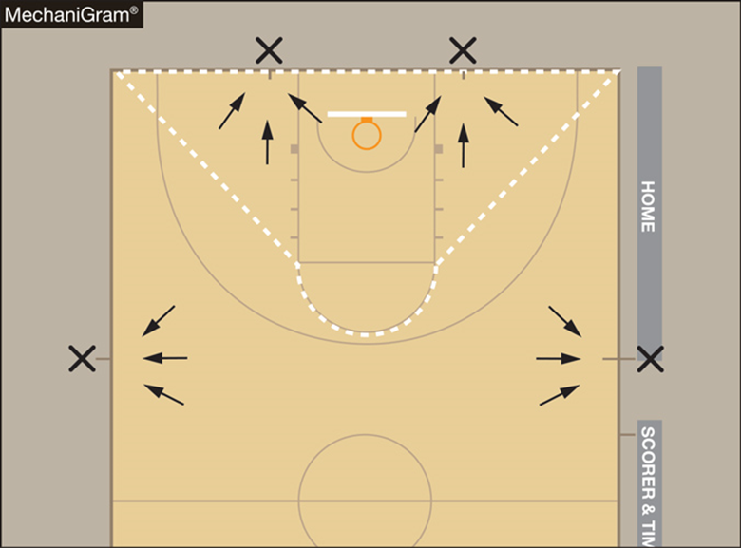
Resumption of play procedure, throw-ins [7-5-2 thru 4 (NEW)]
Frontcourt throw-ins – Officials shall determine the throw-in spot by using an imaginary line (dotted line).
If the stoppage of play occurs inside the dotted imaginary line, the spot shall be the nearest point on the end line 3-feet outside the lane line.
If the stoppage of play occurs outside the dotted imaginary line, the spot shall be the nearest 28-foot mark along each sideline.
NOTE: Court markings are not required.
Notes:
Frontcourt throw-ins – Officials shall determine the throw-in spot by using an imaginary line (dotted line).
If the stoppage of play occurs inside the dotted imaginary line, the spot shall be the nearest point on the end line 3-feet outside the lane line.
If the stoppage of play occurs outside the dotted imaginary line, the spot shall be the nearest 28-foot mark along each sideline.
NOTE: Court markings are not required.

Slide 9
Throw-in administration 7-6-6
When an official administers a throw-in to the wrong team, the officials may now rectify the mistake at any time before the first dead ball after the ball becomes live unless there is a change in possession.
After the ball becomes dead or the correct team gains possession, the time to correct the mistake has expired.
Notes:
When an official administers a throw-in to the wrong team, the officials may now rectify the mistake at any time before the first dead ball after the ball becomes live unless there is a change in possession.
After the ball becomes dead or the correct team gains possession, the time to correct the mistake has expired.
Rationale: Allows for a correction of an official's mistake in a more reasonable timeframe.

Slide 10
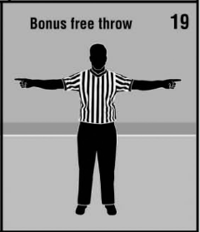
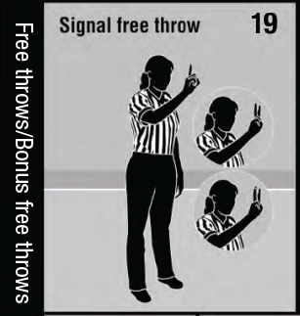
Official NFHS Basketball Signals
Officials Signal #7 – Clarified description to include throw-in violation.
Officials Signal #19 – Removed “Bonus free throw” signal and included “Bonus free throws” in title of new #19 “Signal free throw.”
Notes:
Officials Signal #7 – Clarified description to include throw-in violation.
Officials Signal #19 – Removed “Bonus free throw” signal and included “Bonus free throws” in title of new #19 “Signal free throw.”

Slide 11
Three-person mechanics Overview
2023-25 Basketball Officials Manual

Slide 12
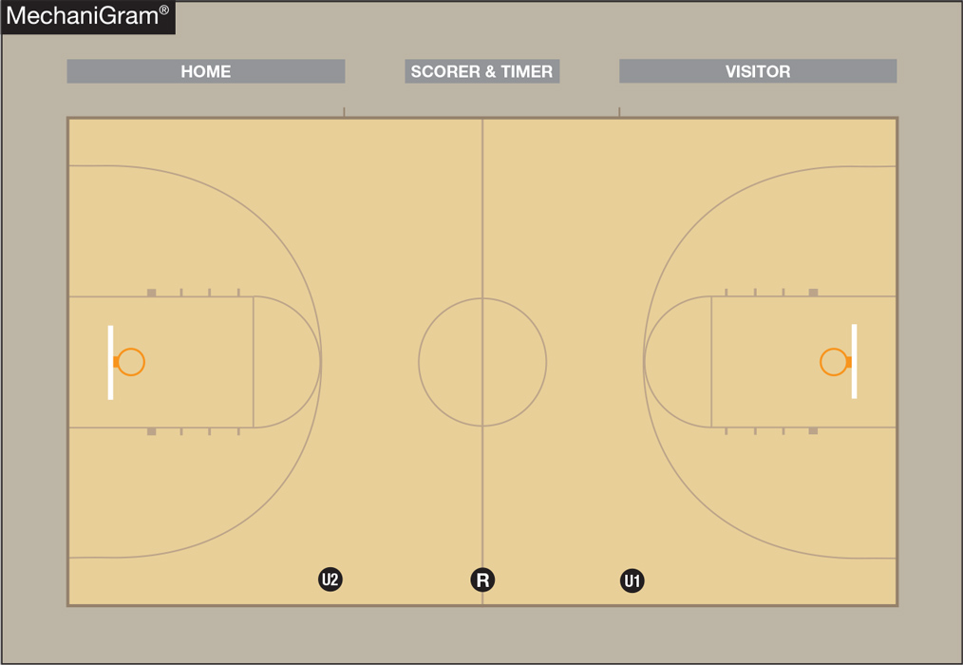
Pregame positions
U1 observes the home team during warm-ups.
U2 observes the visiting team during warm-ups.

Slide 13
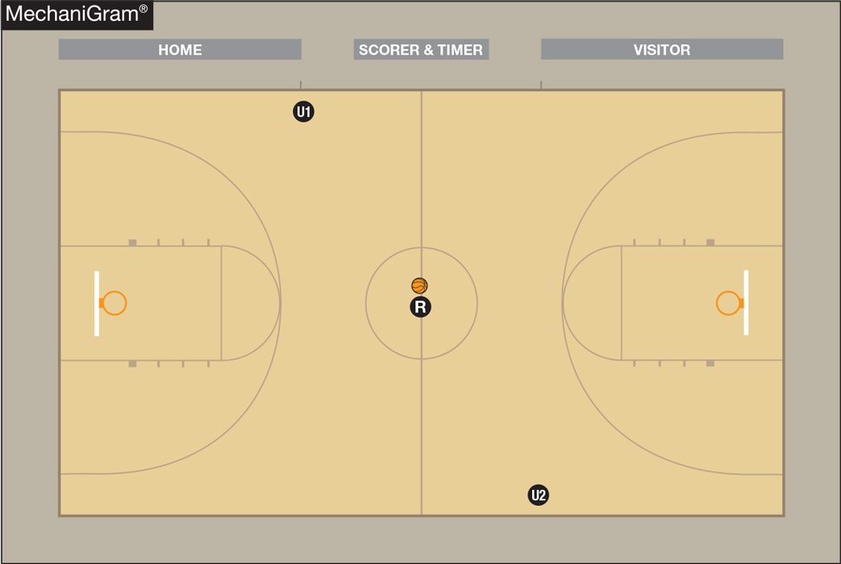
Jump ball
U1 is primarily responsible for calling back a poor toss, signaling the clock to start and counting the home team players.
U2 is responsible for the position and action of the non-jumpers and counting the visiting team players.
U1 & U2 must be mindful of a quick three-point attempt or a backcourt violation.

Slide 14
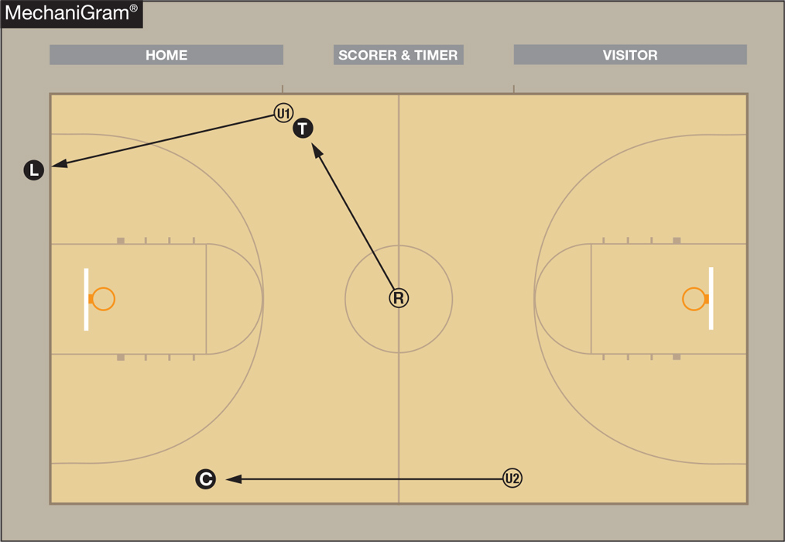
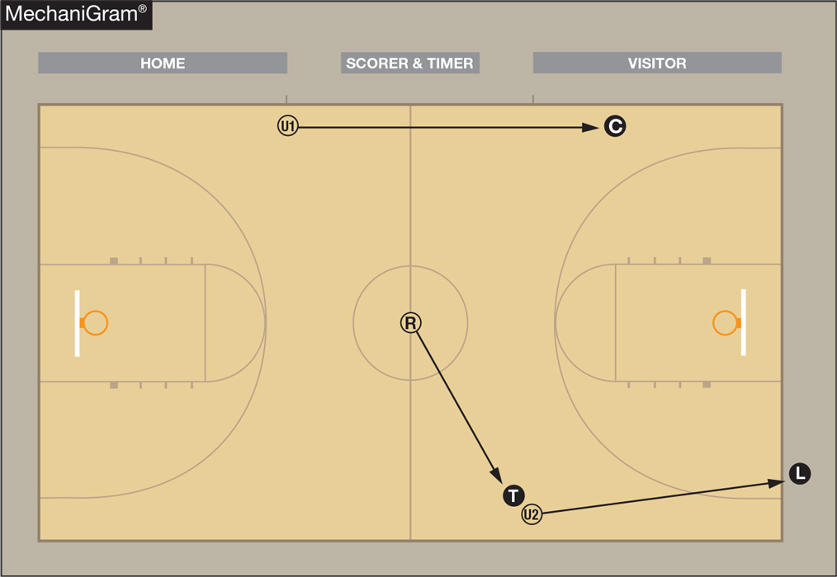
Jump ball
Ball goes left
Ball goes right
The Referee (tossing official) always goes into Trail position.

Slide 15
Time-outs & intermissions
Administering official stays with ball at resumption of play location. If that official needs to leave the spot, a partner should hold the ball at the throw-in spot.
Positioning of non-administering officials:
60-second time-out/intermission – blocks farthest from the team benches.
30-second time-out – top of three-point arc.
Officials should observe bench and table activity.

Slide 16
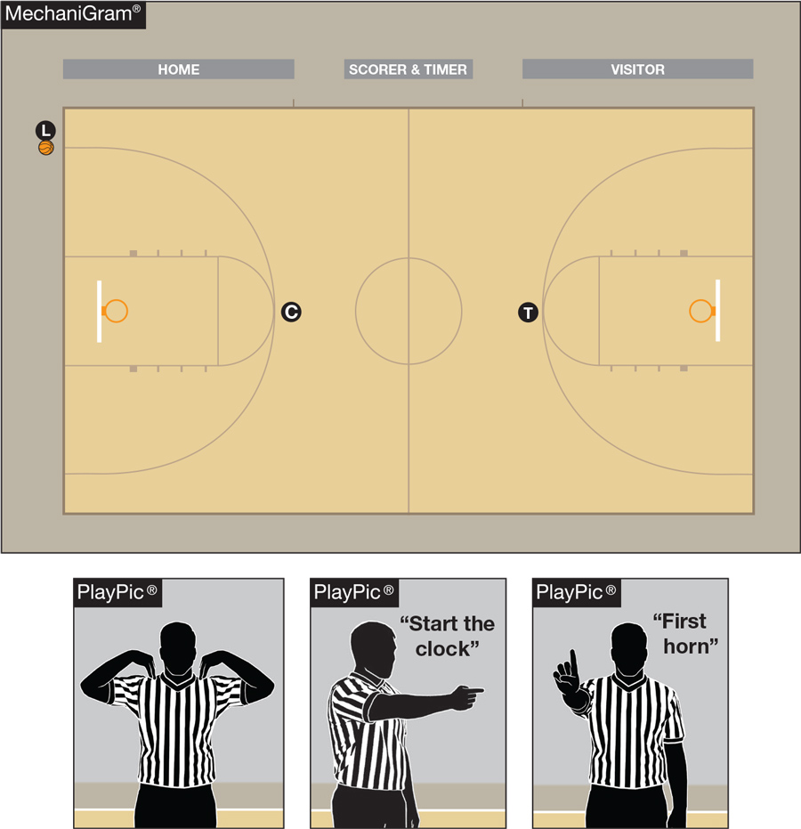
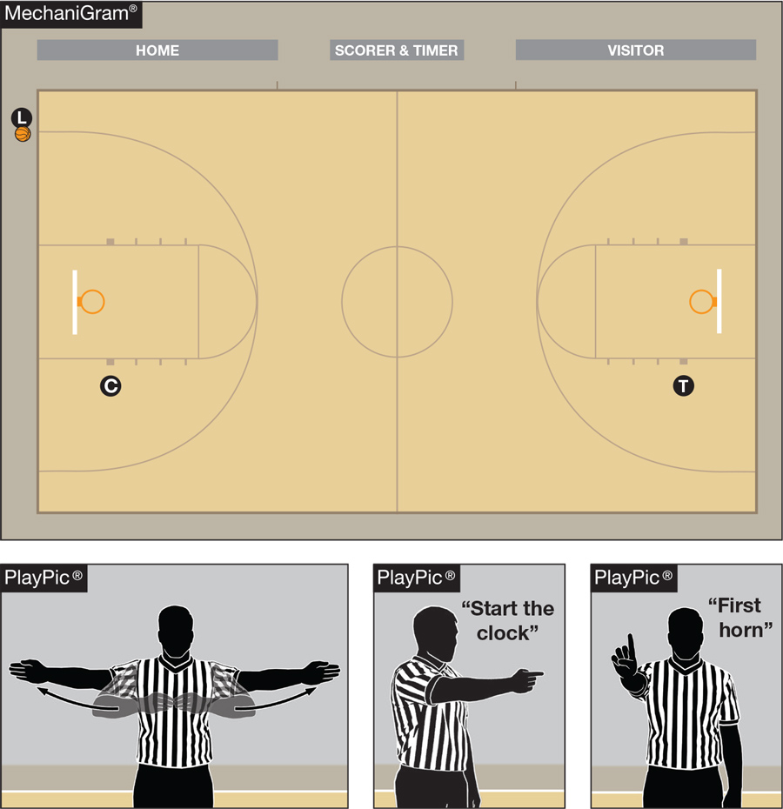
Time-outs & intermissions

Slide 17
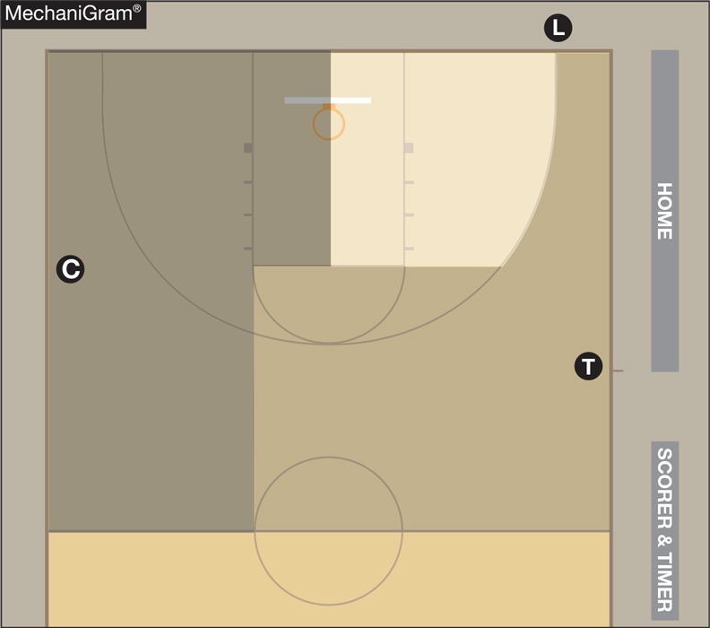
Primary coverage areas
In the front court, each official has a particular area of responsibility. Those areas do not change if the official is on the ball or off the ball.
When the ball comes into an official’s area, that official is on ball.
When the ball leaves an officials’ area, that official is off ball.

Slide 18
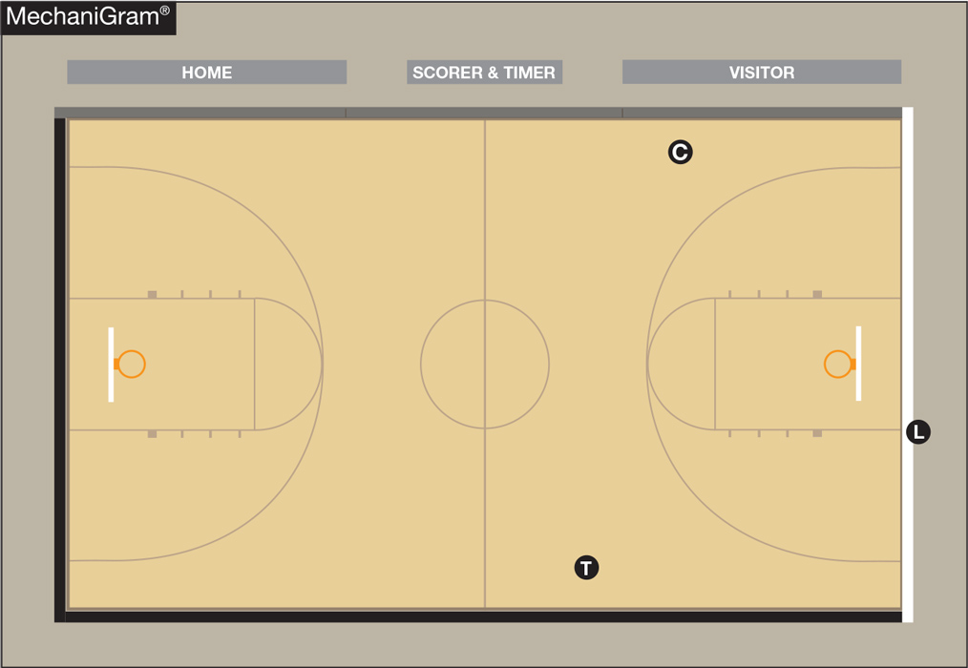
Backcourt Boundary coverage
The Lead is responsible for the entire end line.
The Center is responsible for the closest sideline.
The Trail is responsible for the closest sideline and far end line.
Officials should only call the lines for which they are responsible unless the ruling official asks for help.

Slide 19
Halfcourt boundary coverage
The Lead is responsible for the frontcourt end line.
The Center is responsible for the sideline nearest the Center.
The Trail is responsible for sideline nearest the Trail and the division line.

Slide 20
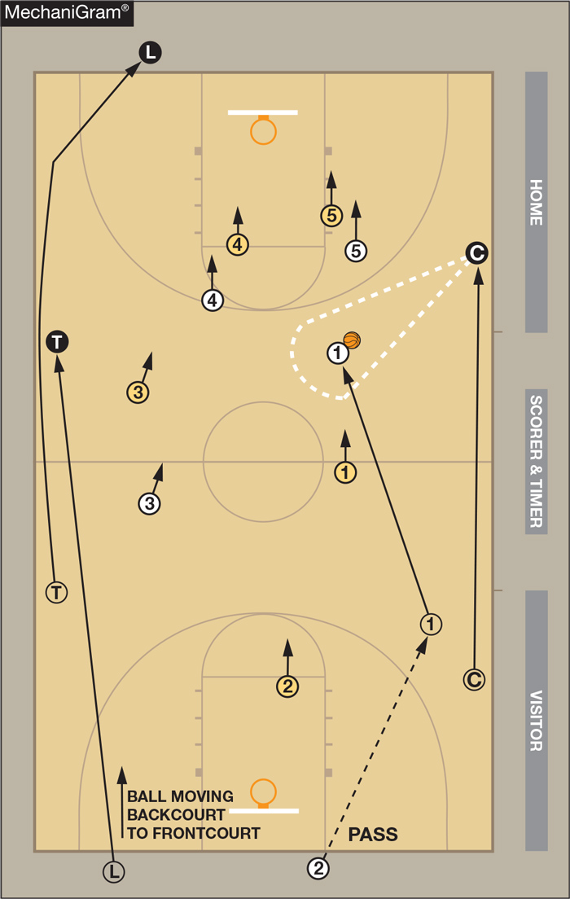
Coverage in transition
The Trail becomes the new Lead.
The Lead becomes the new Trail.
The Center becomes the new Center and is responsible for on-ball coverage as soon as the ball crosses the division line when the ball is on the Center’s side of the court.

Slide 21
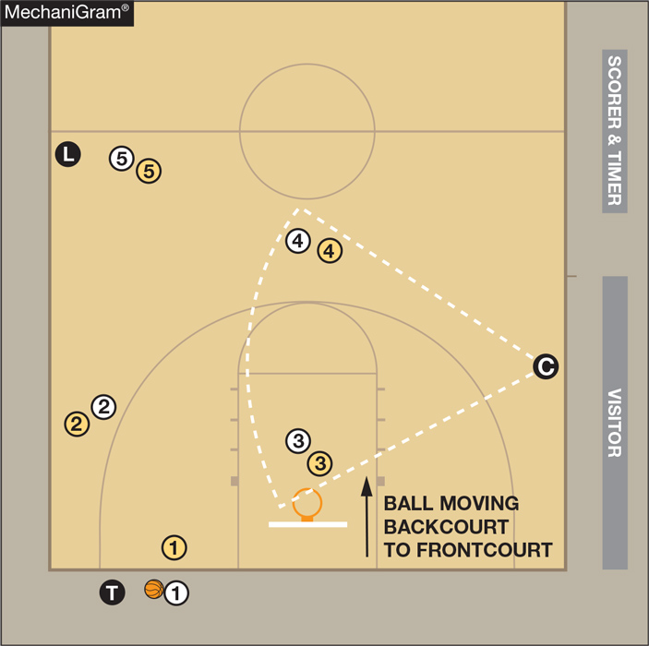
Backcourt Pressure coverage
If there are fewer than four players in the backcourt, the Trail works alone.
If there are more than four players, the Center and sometimes the Lead must help.
The Center stays in place after a made basket and moves to a spot along the sideline for the best angle to officiate action such as illegal screens or holding.
The Lead is positioned a bit beyond the last offensive player on the court.

Slide 22
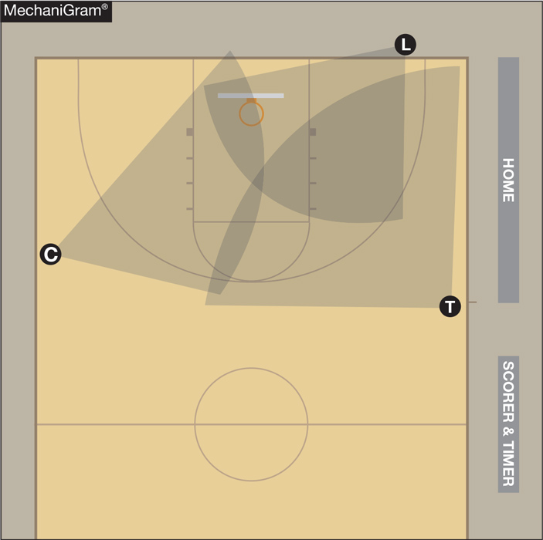
Shot & rebound coverage
The Lead should be positioned outside of the lane lines.
Both the Center and the Trail should close down on shots.
The Center is primarily responsible for weak side rebounding.
When a shot is taken from outside an official’s coverage area, that official should immediately pay attention to the rebounding action.

Slide 23
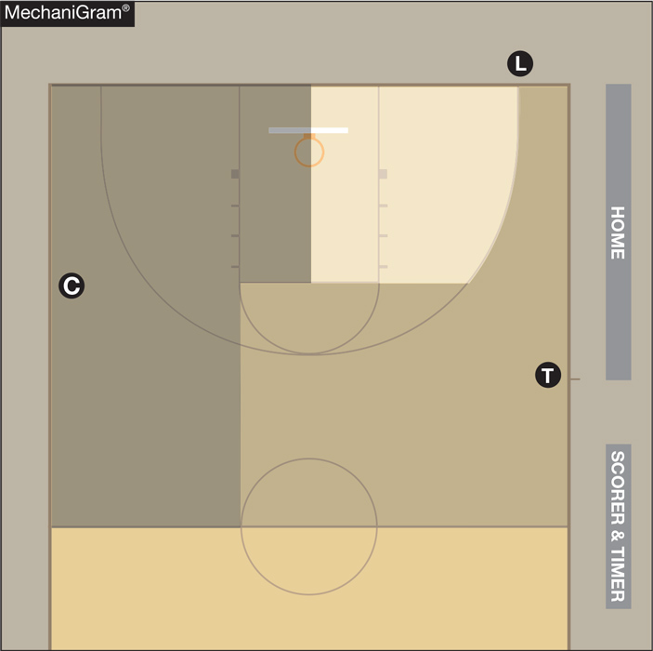
Three-point shot coverage
Only the covering official should indicate the attempt.
The non-covering Center/Trail should mirror the covering official’s “good” signal.

Slide 24
rotations
Rotations should be thoroughly discussed at the pregame conference.
Ball location initiates the need for a rotation.
In most cases during a game, the Lead dictates the rotation.
A rotation should only take place when all three officials are in the frontcourt.
A rotation begins when the Lead moves laterally and penetrates the key area.

Slide 25
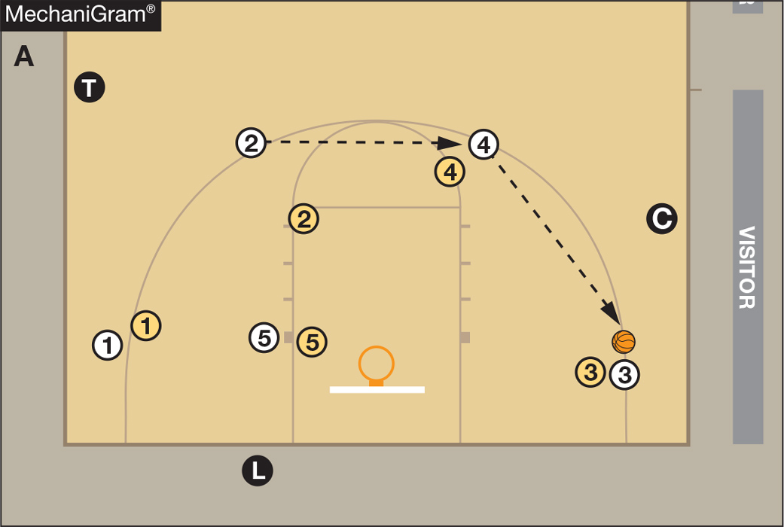
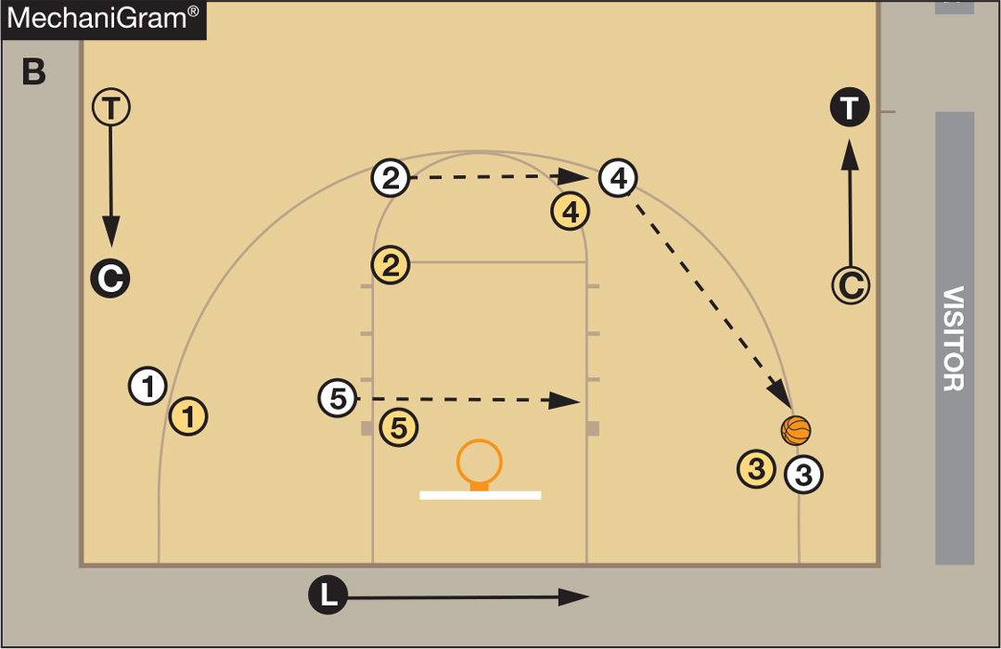
Rotations

Slide 26
Rotations
Rotation is not complete until the Lead passes beyond far lane-line extended.
The Lead must officiate play in the post – even while moving across the lane.
If the Lead begins to rotate and ball is quickly reversed, or a quick shot taken – the Lead does not have to complete the rotation.

Slide 27
rotations
If a trap occurs near the division line on the Center’s side of court, the Center moves higher to officiate that play and the Lead should initiate a rotation.
If the Lead does not rotate – the Center should go back to a normal Center position when play permits.

Slide 28
Transfer after rotation
All officials must recognize rotation has occurred.
If the Lead rotated late and a transition occurs – it is the old Lead’s (new Trail’s) responsibility to look up court making sure partners picked up rotation.
If not, the new Trail should be prepared to adjust location on the floor.

Slide 29
Throw-in cues
The Lead may administer throw-ins on either side of a player in the frontcourt.
To assist the timer, the Trail mirrors the stop- and start-clock signals.
The Trail handles all throw-ins in the backcourt – regardless of location.
All throw-ins on the frontcourt end line are to be administered by handing the ball to the thrower.
The Trail should bounce any sideline or end line throw-in, unless there is defensive pressure.

Slide 30
Out of Bounds Throw-in
After an out of bounds violation in either the frontcourt or the backcourt by either team, the throw-in shall be administered by the covering official at the designated spot nearest to where the ball went out of bounds.
Notes:
After an out of bounds violation in either the frontcourt or the backcourt by either team, the throw-in shall be at the designated spot nearest to where the ball went out of bounds.

Slide 31
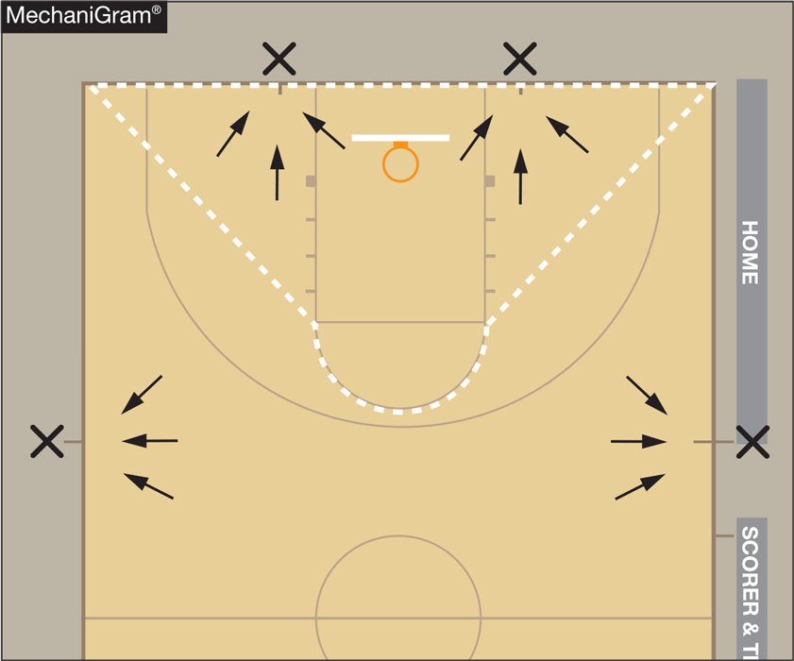
Designated Spots in the frontcourt
A frontcourt designated spot thrown-in is caused by:
A foul before the bonus;
A violation; or
A stoppage (i.e., an inadvertent whistle or time-out).
Designated spot frontcourt throw-ins are administered at one of the four spots shown in the Mechanigram.

Slide 32
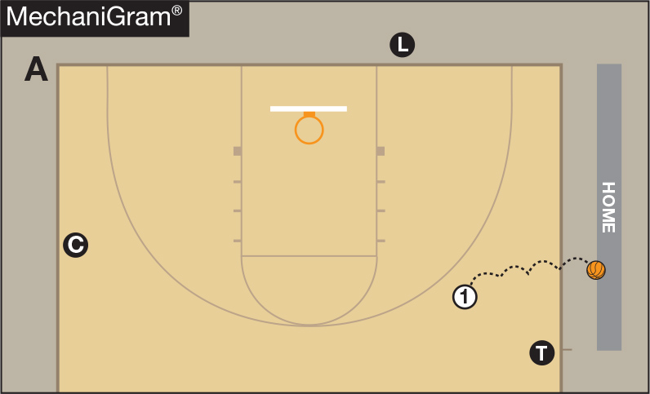
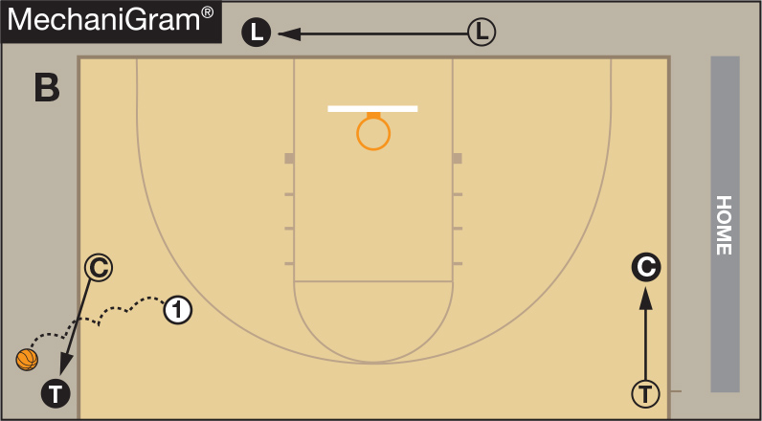
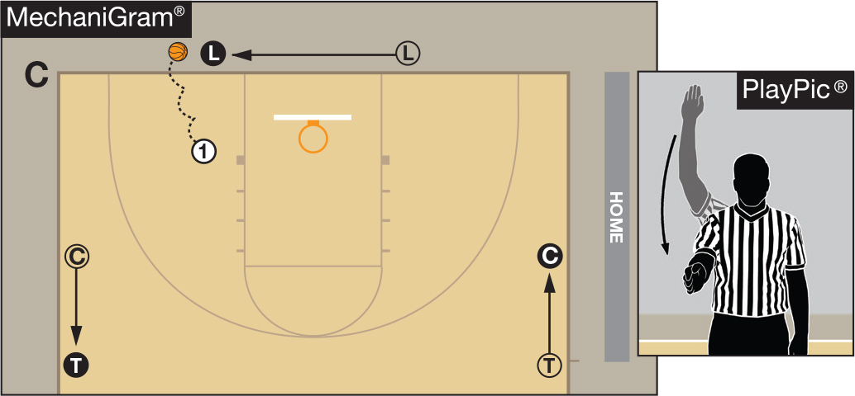
Sideline throw-ins in the backcourt
All throw-ins will be handled by the covering official.
In B, the Center administers the throw-in and becomes the new Trail. The Lead slides over to the same side as the throw-in and the Trail slides down and becomes the new Center.
In C, the Lead slides over to administer the throw-in. The Center slides toward the division line and becomes the new Trail and mirrors the Lead’s “start clock” signal and the Trail slides down and becomes the new Center.

Slide 33
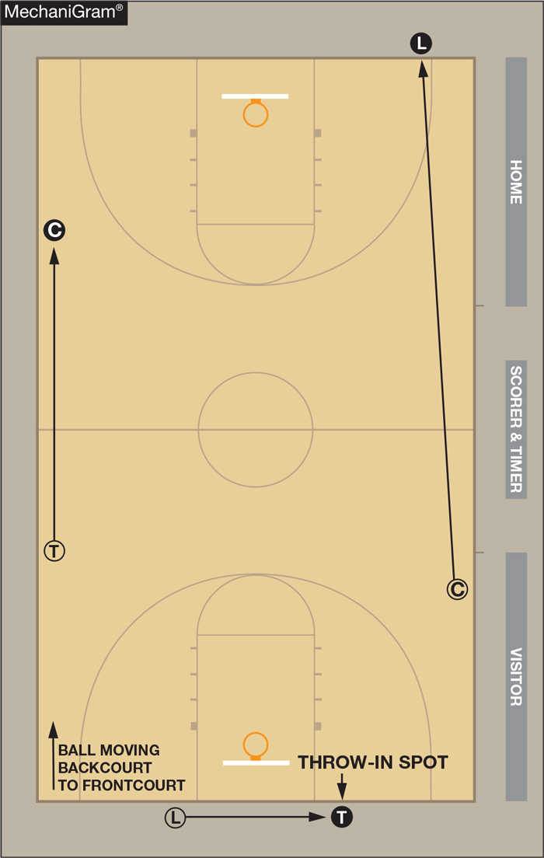
Backcourt Throw-in
When the administering official is on the opposite side of the lane from the inbound spot, the official should move across the lane. Do not bounce the ball across the lane.
The old Center moves downcourt and becomes the new Lead.
The old Trail moves downcourt and becomes the new Center.
The old Lead becomes the new Trail.

Slide 34
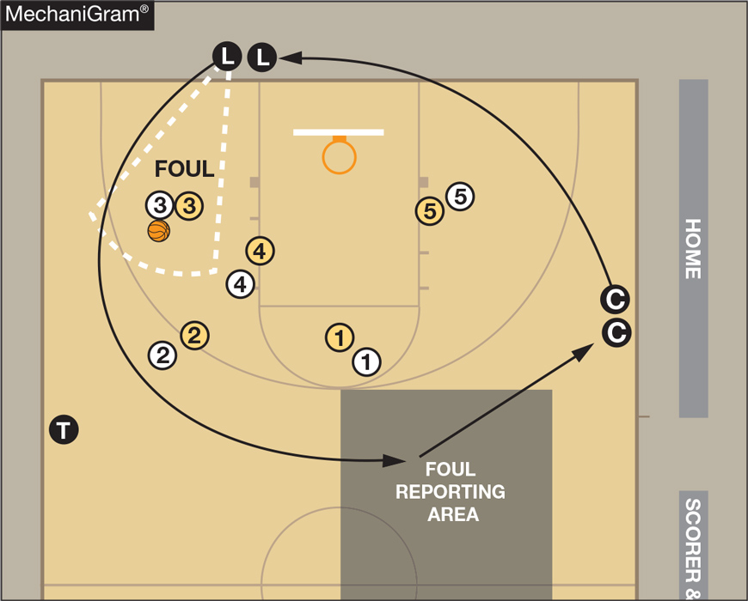
Foul reporting

Slide 35
Fouls & basic switching
Non-calling officials should observe all players.
Calling official goes tableside after reporting.
Official originally tableside fills the vacancy left by the calling official.
Third official remains in same position occupied at time of foul.
If calling official was tableside, no switch occurs.

Slide 36
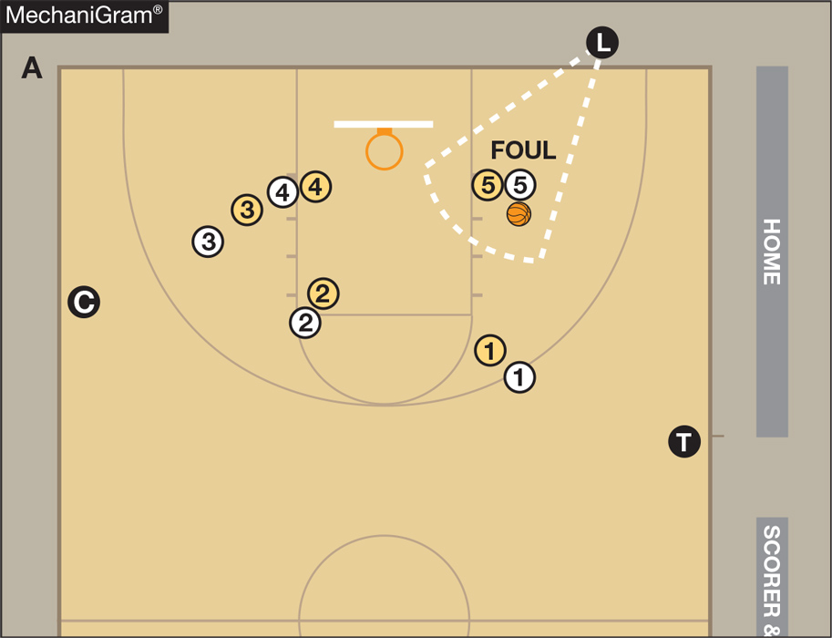
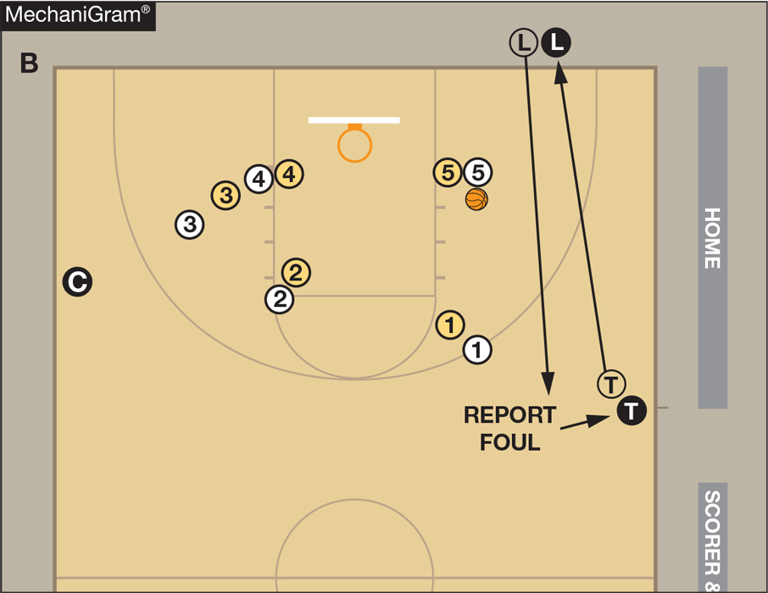
Foul reporting & switching
The Lead calls a tableside foul, goes to reporting area, reports the foul, and stays tableside as the new Trail.
The Trail becomes new Lead.
The Center remains the Center.

Slide 37
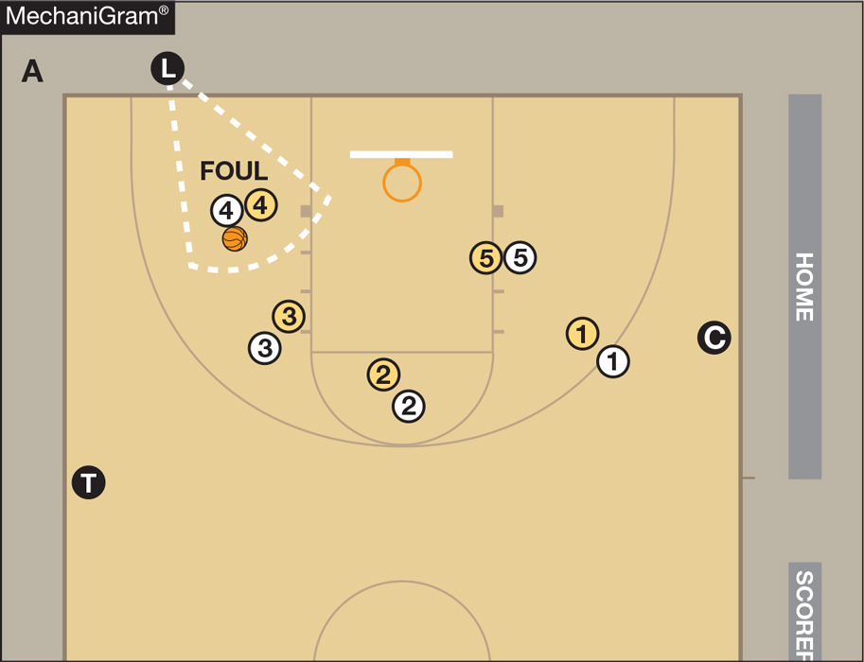
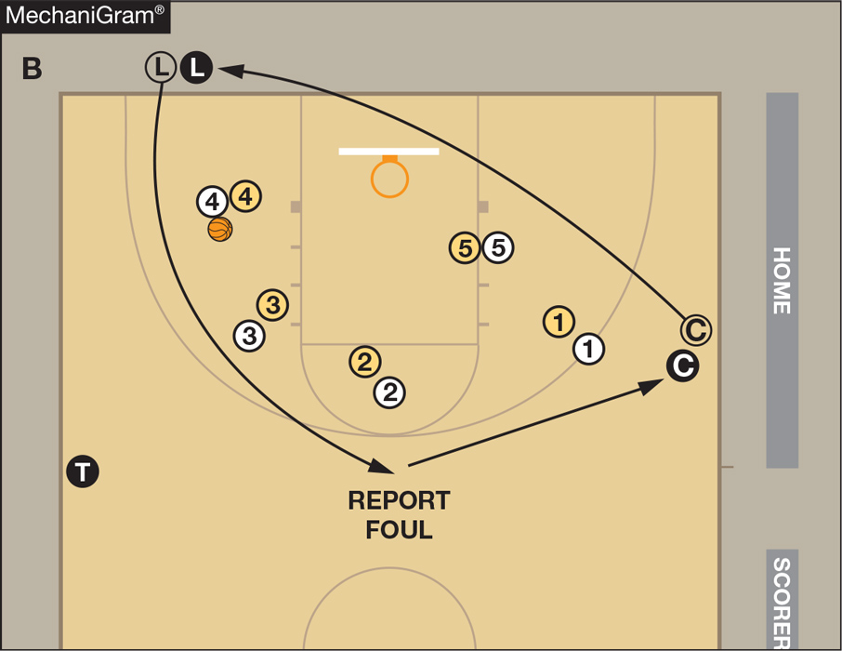
Foul reporting & switching
The Lead calls a foul opposite the table, goes to reporting area, reports the foul and stays tableside as the new Center.
The Center becomes new Lead.
The Trail remains the Trail.

Slide 38
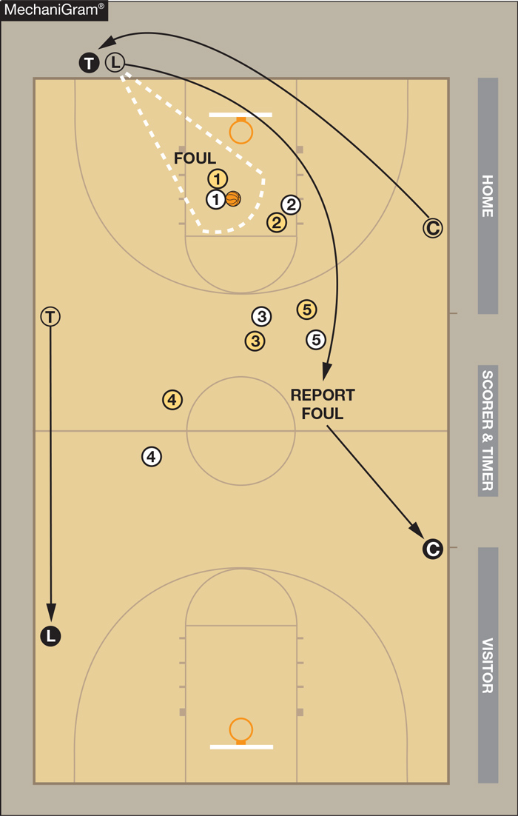
Foul reporting & switching on offensive calls
The Lead calls a foul opposite the table, reports the foul and moves to the front court to become the new Center.
The old Trail becomes the new Lead.
The old Center becomes the new Trail and administers the throw-in.

Slide 39
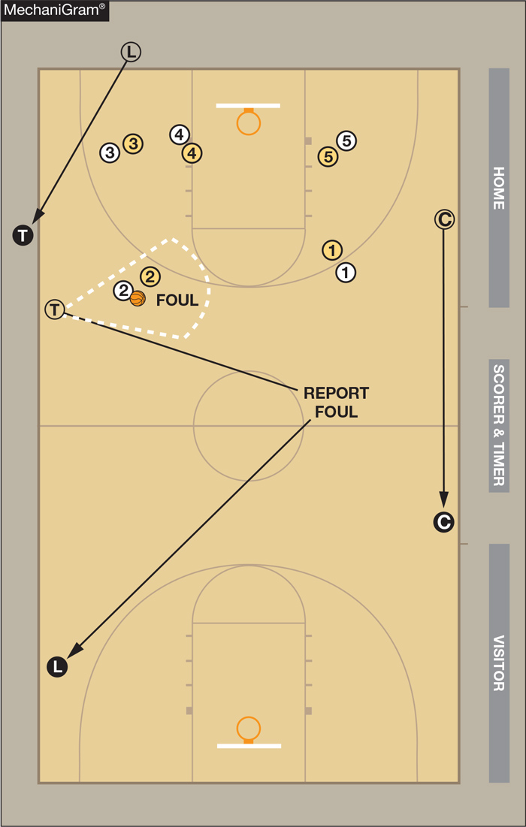
Foul reporting & Switching on offensive calls
The Trail calls a foul opposite the table, reports the foul and moves opposite to become new Lead. In this instance, the calling official does not go tableside.
The old Center becomes new Center.
The old Lead administers the throw-in along the sideline and becomes new Trail.

Slide 40
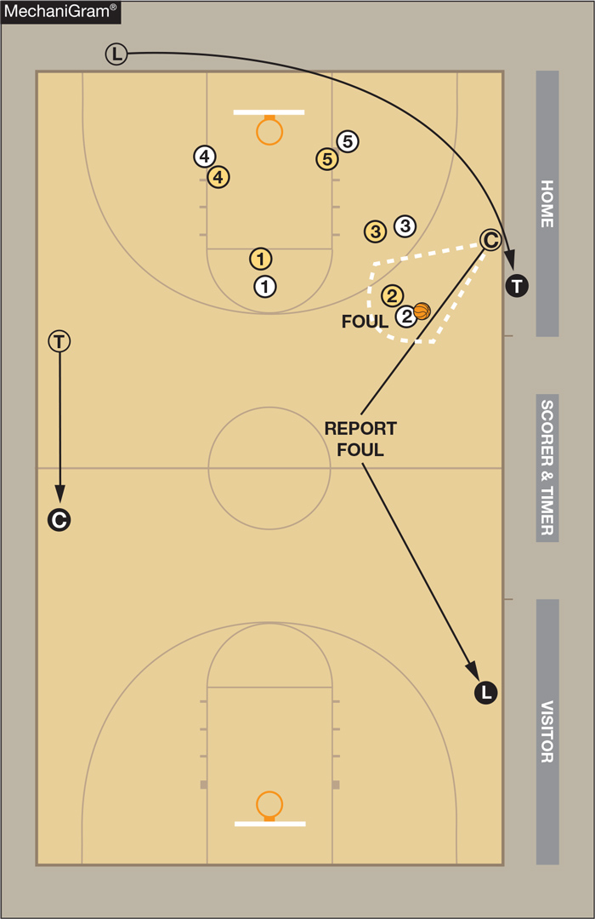
Foul reporting & switching on offensive calls
The Center calls a foul tableside, reports the foul, stays tableside and slides down to become new Lead.
The old Trail becomes the new Center.
The Lead moves to the sideline to administer the throw-in and becomes new Trail.

Slide 41
Disqualification procedure
The calling official (new tableside Center or Trail):
Notifies the coach;
Requests timer to begin the 15-second replacement clock; and
Notifies disqualified player.
If informing the coach could be confrontational, the calling official may notify the table and go opposite. The opposite Trail or Center, should move tableside and notify the coach.
Officials not administering the disqualification should position for subsequent throw-in or free throw.
Administering official takes a position on the division line halfway between center circle and sideline nearest table to administer the substitution.

Slide 42
Free throws
Calling official becomes the Trail and observes all lane activity to assist the Center and Lead and watches any action above the three-point arc.
The Lead administers all free throws and watches players on the opposite lane line (closer to the Center) and the lane spaces nearest the Lead.
The Center has responsibility for shooter (including the 10-second count), flight of ball, and top two-lane spaces on the opposite lane line.
The Center and Trail close down on last shot attempt.

Slide 43
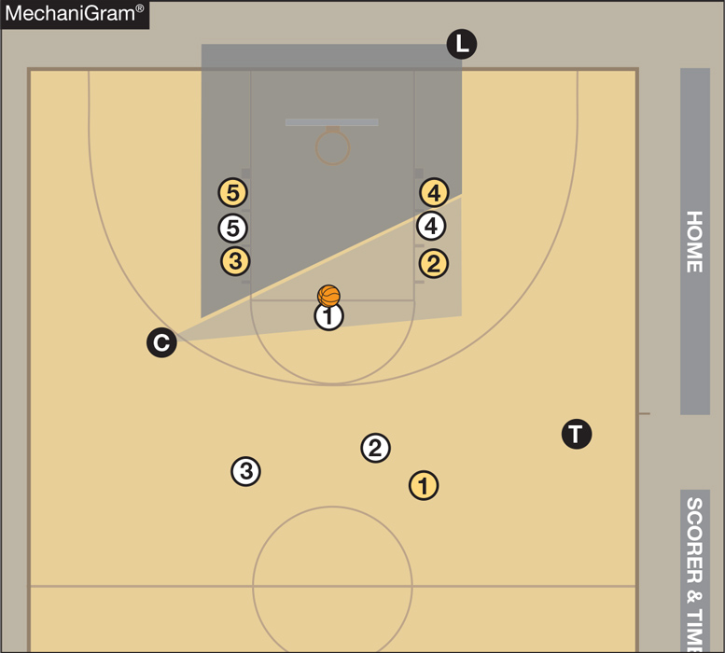
Free throws
The Trail is at approximately the 28-foot mark and just inside the tableside boundary line.
The Lead is approximately 4 feet outside of the nearer lane line and off the end line for ALL free throws.
The Center is halfway between the near lane line and the sideline; just above the free-throw line extended.

Slide 44
Thank you!
www.nfhs.org

